Slide 1
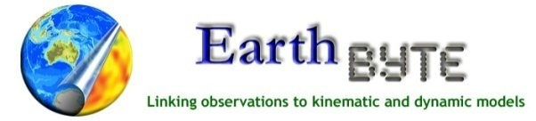
Lessons from the Miocene Climatic Optimum
100 years from now…
Nature’s Fury
November 5th, 2007, Australian National University
Nicholas Herold
The University of Sydney

Slide 2
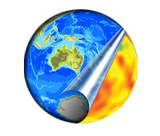
Agenda
1. The Miocene Climatic Optimum (MCO)
  1.1 Low equator-to-pole temperature gradient.
  1.2 Mechanisms of warming.
2. What mechanisms which existed during the MCO can we realistically expect in a future “greenhouse” scenario?
Notes:
Mention model simulations

Slide 3
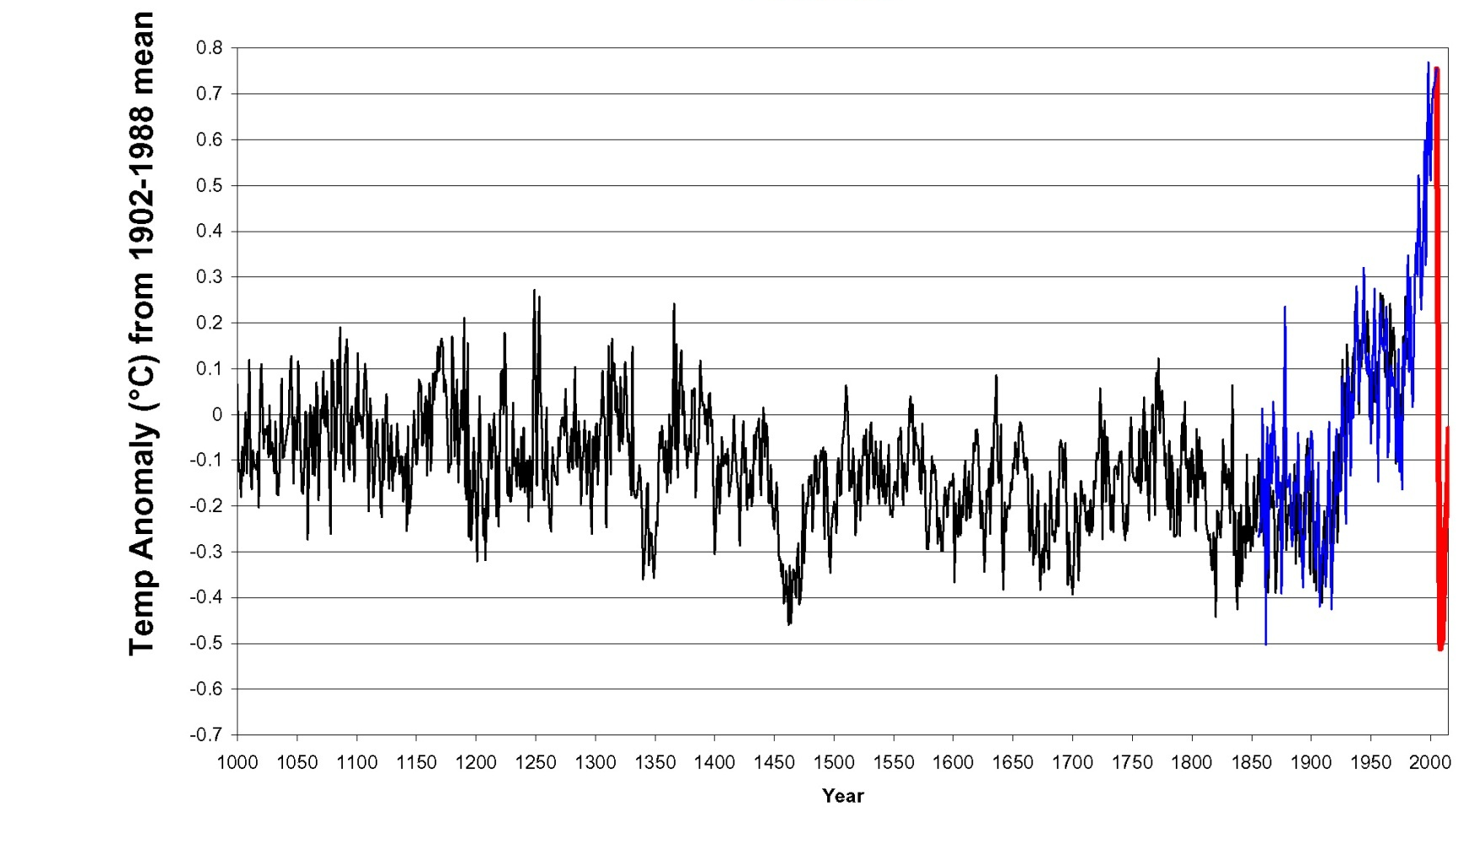
Centennial scale surface temperature change
Year
Robock et al. (2007)‏

Slide 4
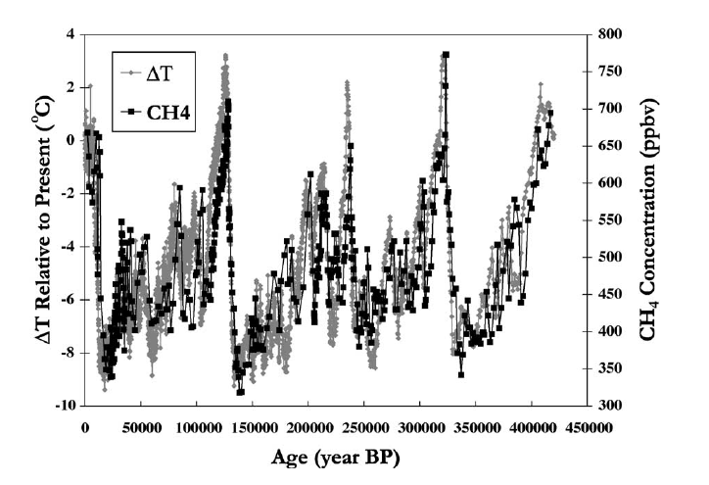
Glacial scale surface temperature change
Wuebbles and Hayhoe (2002)‏

Slide 5
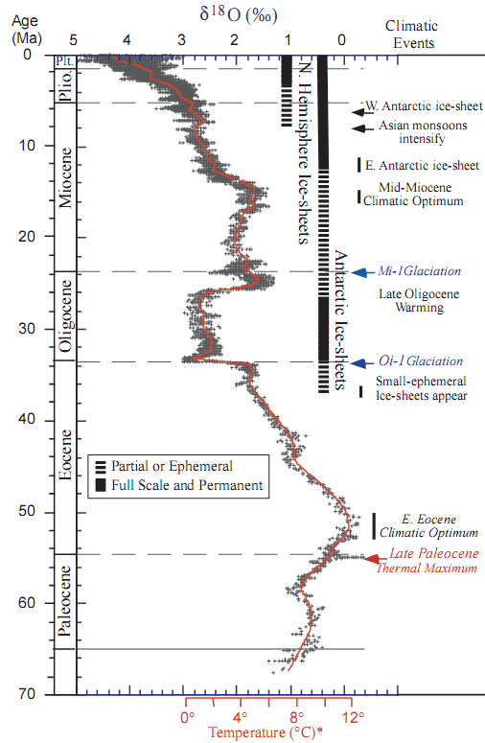
Warmth in a cooling Cenozoic
Miocene Climatic Optimum (MCO)
TIME (Ma)
Zachos et al. (2001)
Notes:
MCO ~17.5 – 14.5 Ma
Warmest in the past 35 million years,

Slide 6
Miocene and modern zonal temperature profiles
Notes:
Poles much warmer, ice-albedo feedback is not enough to account for this. Talk about later.
Tropics slightly cooler. These are common features of greenhouse periods, the million dollar question for decades now, and is more severe at other intervals considering the MCO is relatively mild in comparison to the Eocene and Cretaceous greenhouses.
- No high latitude data, continental temperatures for Antarctica would be particularly useful. Data from the Arctic may become available over the next couple of years due to successful drilling of the Lomonosov ridge.

Slide 7
Causes of warming...
CO₂, CH₄, vegetation, topography, orbital parameters, solar emissivity, ocean heat transport, ice-sheet volume, sea-level rise, aerosols...
Notes:
From a modelling perspective there are many boundary conditions that can and most likely have contributed to global warming, many of which are tightly coupled to one another.

Slide 8
Mechanisms of high-latitude warming
Ocean Heat Transport
Greenhouse Gases
Notes:
In terms of the ultimate causes of warming, I want to focus on OHT and GHG’s, since these are the current candidates for explaining high latitude warming.

Slide 9
Ocean Heat Transport in a Greenhouse World
Originally thought responsible for high latitude warming however has minimal effect on high latitude continental interiors.
Recent estimates show that 5% of modern poleward heat transport past 60° south and north is attributable to the oceans.
Vertical mixing sensitivity to the vertical density gradient may have increased thermohaline circulation.
Notes:
From the 70’s to 90’s OHT was invoked as the most likely form of polar warming responsible for the low equator-to-pole temperature gradients observed in the record for various greenhouse worlds. Though no mechanisms was ever identified which may have caused such a high rate of circulation.
However in the 80’s and early 90’s simulations, mainly by Eric Barron, and work by Lisa Sloan started to question this. Lisa Sloan and her collaborators calculated that to maintain early Eocene temperatures at those seen in the record, a ~30% increase in OHT would be required.
This was stimulated by the fact that no mechanism could be suggested to increase OHT so much and also that simulations with enhanced OHT show that while polar ocean temperatures increased, they had minimal effect on the continental interiors. So this suggested the role of the atmosphere.
More recent work by Trenberth also showed that only 5% of the heat transported north of 60 degrees latitude is through the oceans, though feedback effects could amplify any changes to this value.
Mitchell Lyle, from a simple ocean model, showed that if the strength of vertical mixing in the deep ocean was sensitive to the oceans vertical density structure then thermohaline cirtculation may have been up to 3x stronger than today.

Slide 10
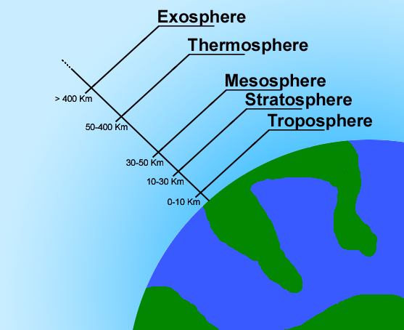
Greenhouse warming
High warming with a low CO₂: the Miocene Climatic Optimum paradox.
Methane a possible puppet master
Polar stratospheric clouds
Notes:
End on the effect of increased GHG on tropics. Transition to next slide.
This has however been debated by Pearson et al. (2001) who claim poor preservation and diagenetic alterations provide an inbuilt bias.

Slide 11
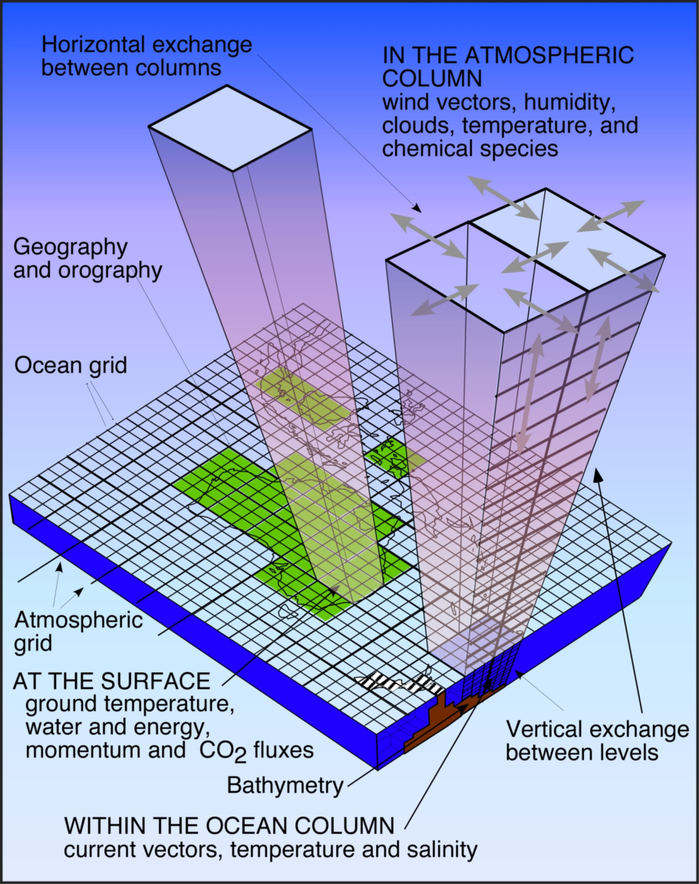
The NCAR General Circulation Model
The Community Atmosphere Model (CAM) and Community Land Model (CLM).
Run at a ~3.75x3.75° resolution with 26 atmospheric layers.
Coupled to a mixed-layer ocean model.
We can prescribe Miocene orbital parameters, greenhouse gases, topography, vegetation, SST, solar constant.
McGuffie and Henderson-Sellers (2005)
Notes:
Simulates energy, heat and moisture transfer within and between the atmosphere and land.

Slide 12
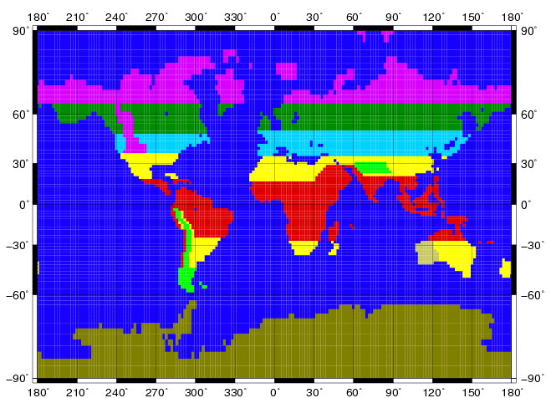
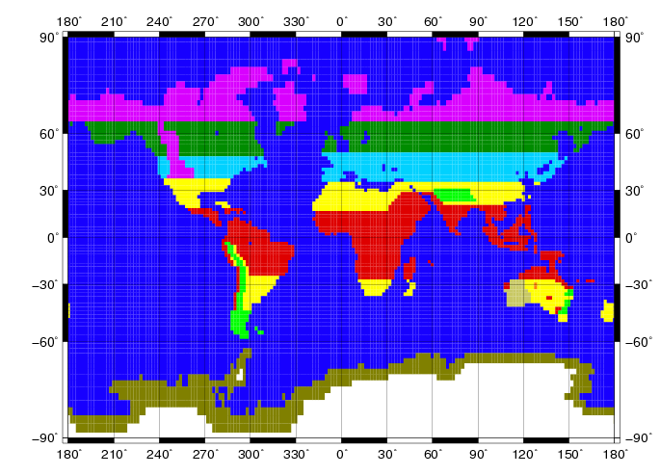
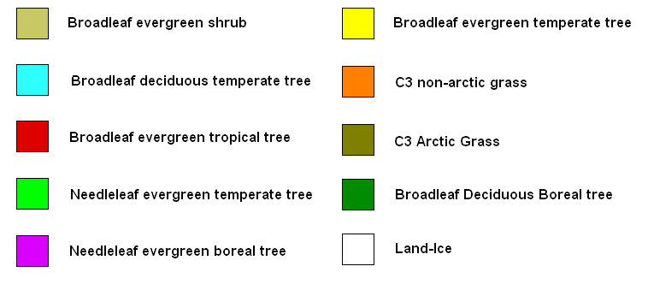
Miocene vegetation

Slide 13
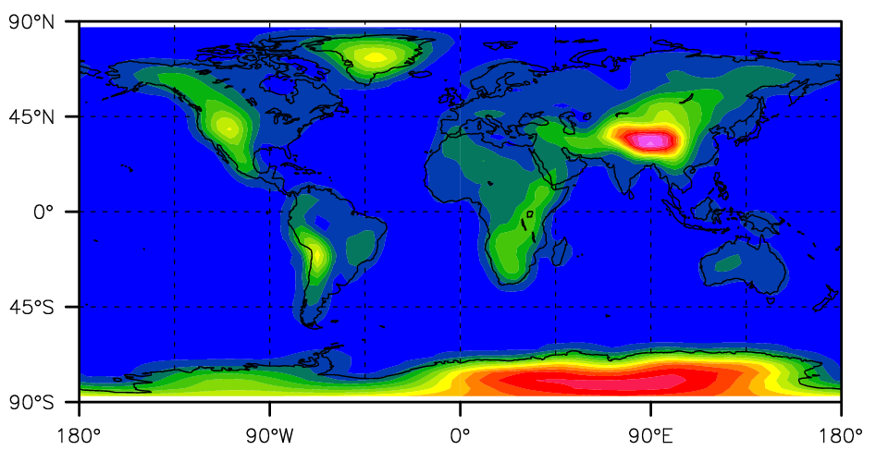
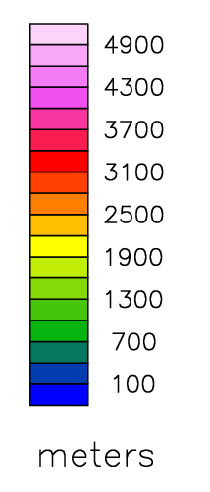
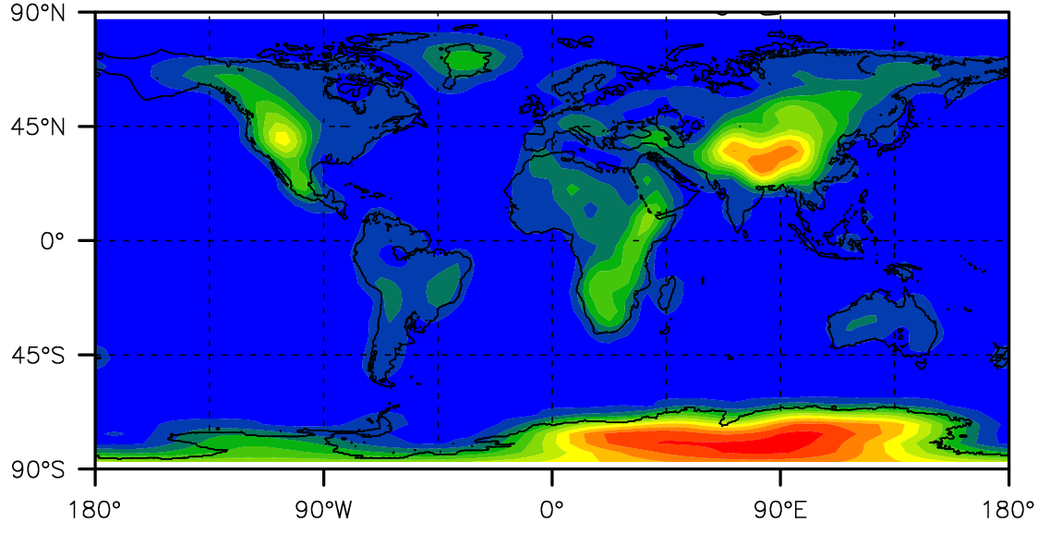
Topography
90°N
MODERN
45°N
0°
45°S
90°S
90°N
MIOCENE
45°N
0°
ELEVATION (m)
45°S
90°S
180°
90°W
0°
90°E
180°

Slide 14
Results

Slide 15
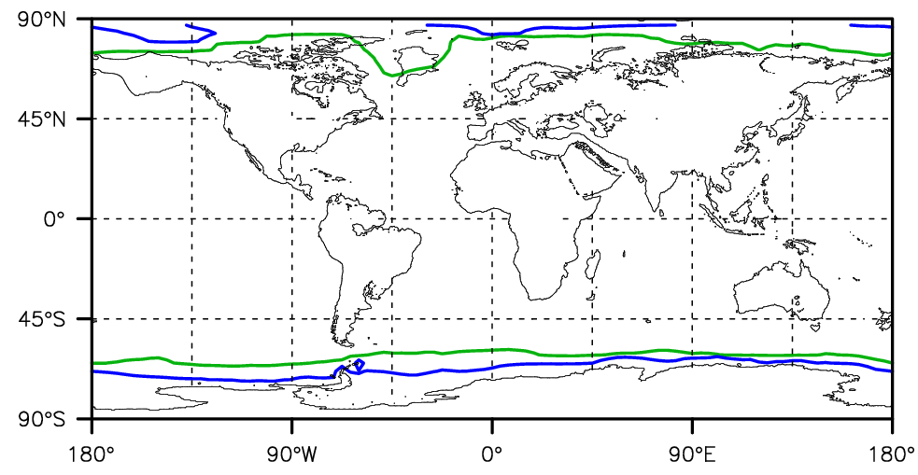
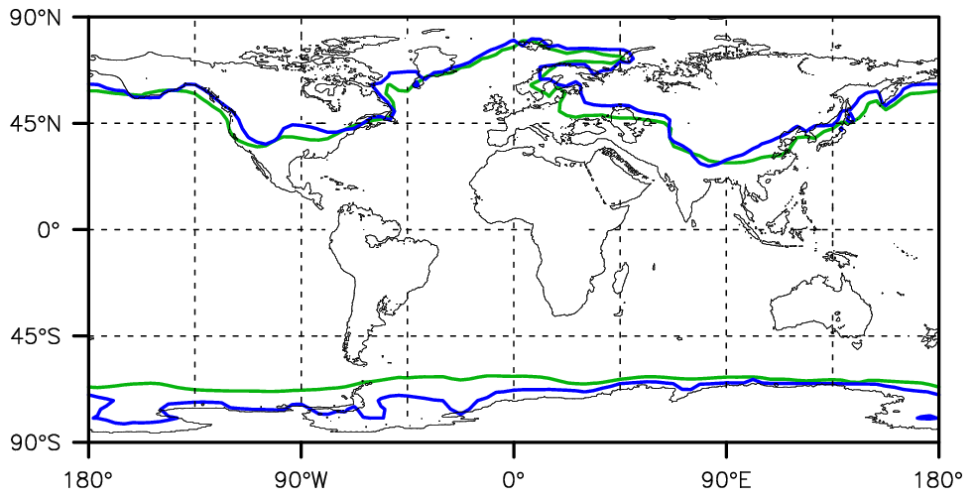
Zero degree isotherm
90°N
June-July-August
MODERN
45°N
0°
MIOCENE
45°S
90°S
90°N
December-
January-February
45°N
0°
45°S
90°S
180°
90°W
0°
90°E
180°
Notes:
Use CO2_700 as an effective CO2 values – this has its own limitations (Wang, 1991)

Slide 16
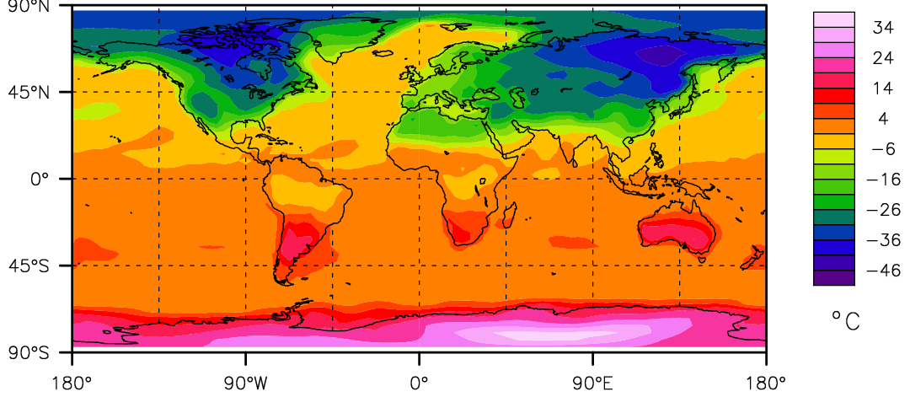
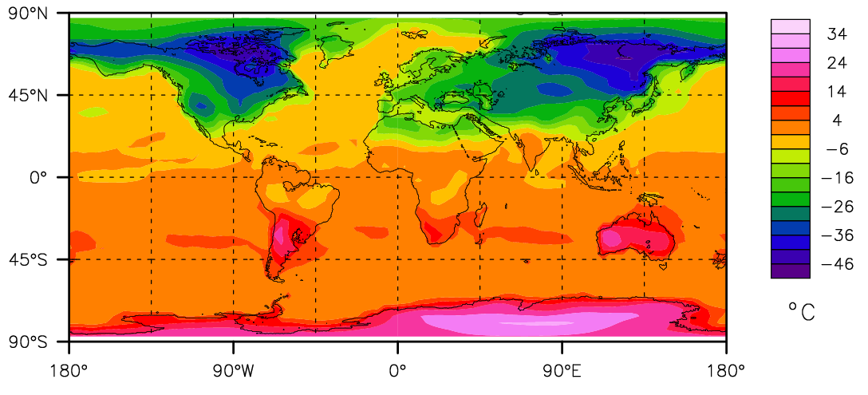
DJF – JJA surface temperature
90°N
MODERN
45°N
0°
45°S
90°S
90°N
MIOCENE
45°N
0°
45°S
90°S
180°
90°W
0°
90°E
180°

Slide 17
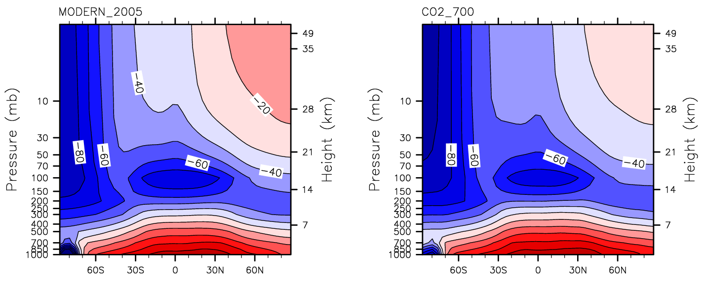
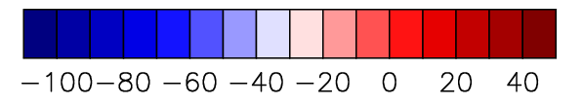
June-July-August atmospheric temperature
MODERN
MIOCENE
LATITUDE
LATITUDE
TEMPERATURE (°C)

Slide 18
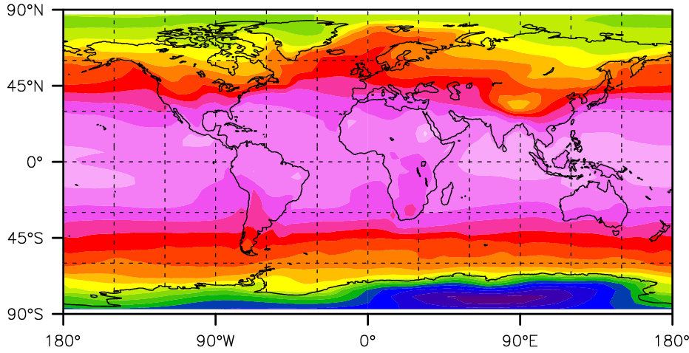
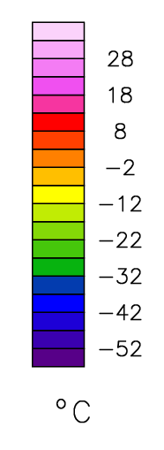
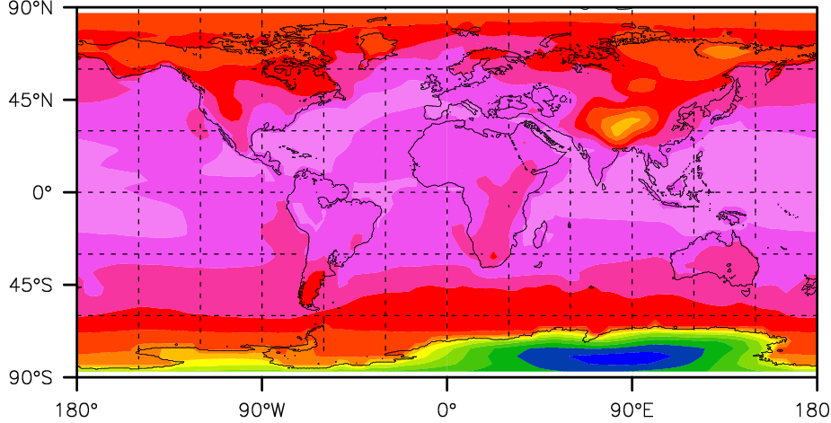
Annual surface temperature
90°N
MODERN
45°N
0°
45°S
90°S
90°N
MIOCENE
(NEW SST)
45°N
0°
45°S
90°S
180°
90°W
0°
90°E
180°

Slide 19
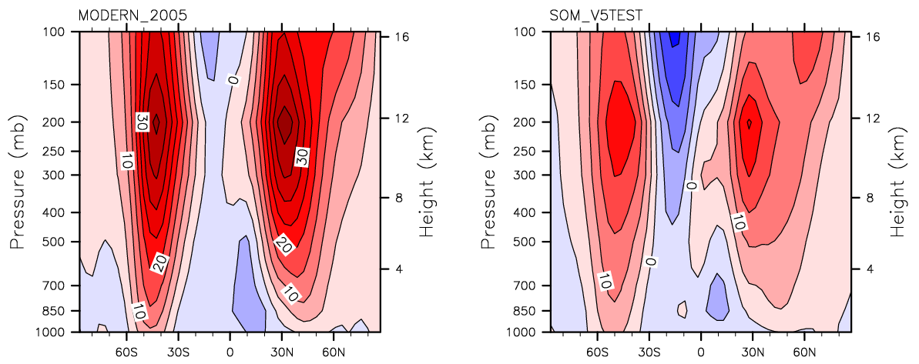
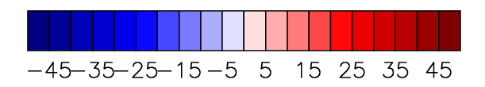
December-January-February wind speed
MODERN
MIOCENE
LATITUDE
LATITUDE
WIND SPEED (m/s)

Slide 20
Current plans
Implement relevant boundary conditions into our model to account for the MCO equator-to-pole temperature gradient.
Apply methodology to another Cenozoic greenhouse period. Build a series of snap shots of warm climates throughout the Cenozoic and into the future.

Slide 21
Concluding Remarks
Many features of pre-Quaternary greenhouse climates may be reproduced during future global warming.
Palaeoclimate study is crucial for identifying and understanding mechanisms of warming not present in the current climate system and in the current generation of climate models.

Slide 22
References
Lyle, M., 1997, Could early Cenozoic thermohaline circulation have warmed the poles?: Paleoceanography, v. 12, p. 161-167.
Robock, Alan, Luke Oman, Georgiy L. Stenchikov, Owen B. Toon, Charles Bardeen, and Richard P. Turco, 2007: Climatic consequences of regional nuclear conflicts. Atm. Chem. Phys., 7, 2003-2012.
Rind, D., Chandler, M., Lonergan, P., and Lerner, J., 2001, Climate change and the middle atmosphere 5. Paleostratosphere in cold and warm climates: Journal of Geophysical Research D: Atmospheres, v. 106, p. 20195-20212.
Schnitker, D., 1980, North Atlantic oceanography as possible cause of Antarctic glaciation and eutrophication: Nature, v. 284, p. 615-616.
Sloan, L.C., Walker, J.C.G., Moore, T.C., Rea, D.K., and Zachos, J.C., 1992, Possible methane-induced polar warming in the early Eocene: Nature, v. 357, p. 320-322.
Sloan, L.C., and Pollard, D., 1998, Polar stratospheric clouds: A high latitude warming mechanism in an ancient greenhouse world: Geophysical Research Letters, v. 25, p. 3517-3520.
Schiermeier, Q., 2006, The methane mystery: Nature, v. 442, p. 730-731.
Woodruff, F., and Savin, S.M., 1989, Miocene deepwater oceanography: Paleoceanography, v. 4, p. 87-140.
Woodruff, F., and Savin, S.M., 1991, Mid-Miocene isotope stratigraphy in the deep sea: high-resolution correlations, paleoclimatic cycles, and sediment preservation: Paleoceanography, v. 6, p. 755-806.
Wuebbles and Hayhoe, 2002. Atmospheric methane and global change.
Zachos, J., Pagani, M., Sloan, L., Thomas, E., and Billups, K., 2001, Trends, rhythms, and aberrations in global climate 65 Ma to present: Science, v. 292, p. 686-693.

Slide 23
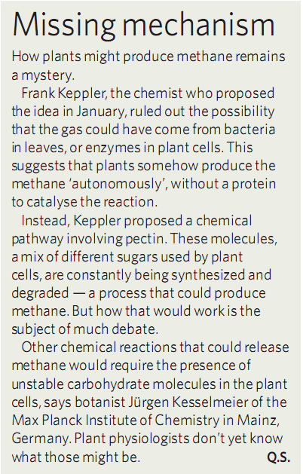

Slide 24
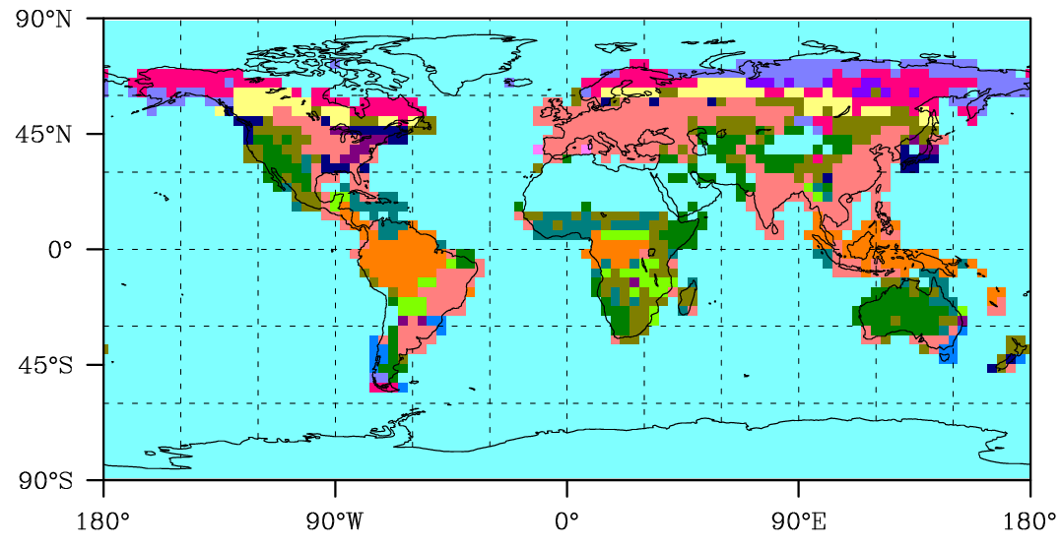
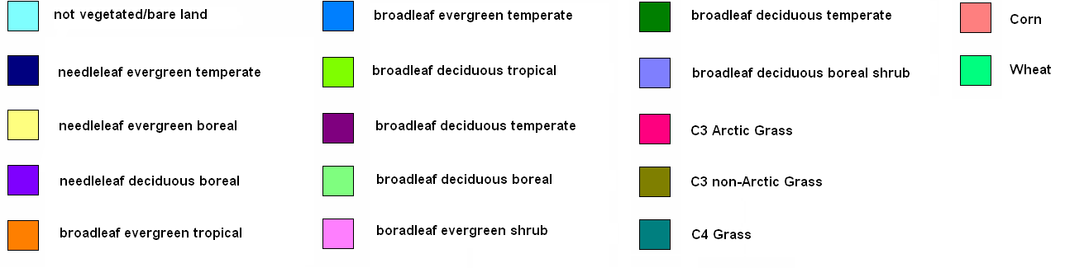
Modern day dominant vegetation

Slide 25
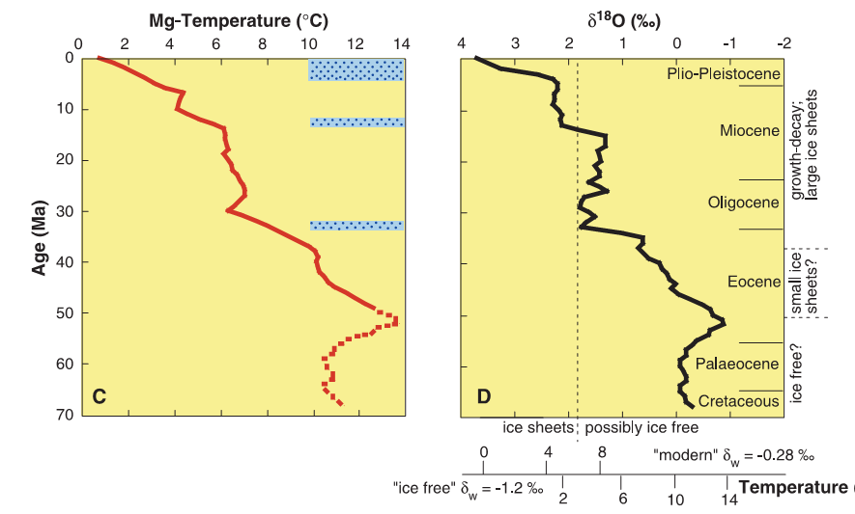
Deep sea temperature record
Lear et al. (2000)

Slide 26
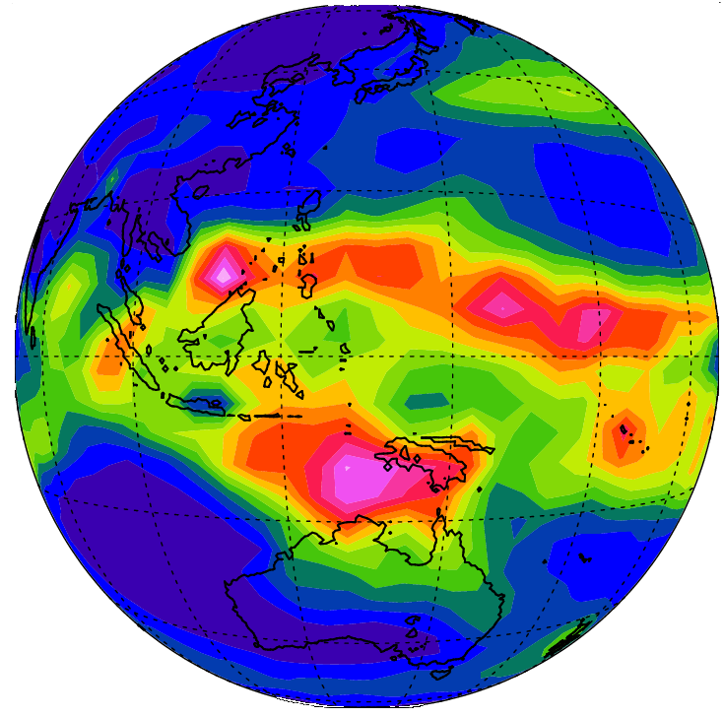

Slide 27
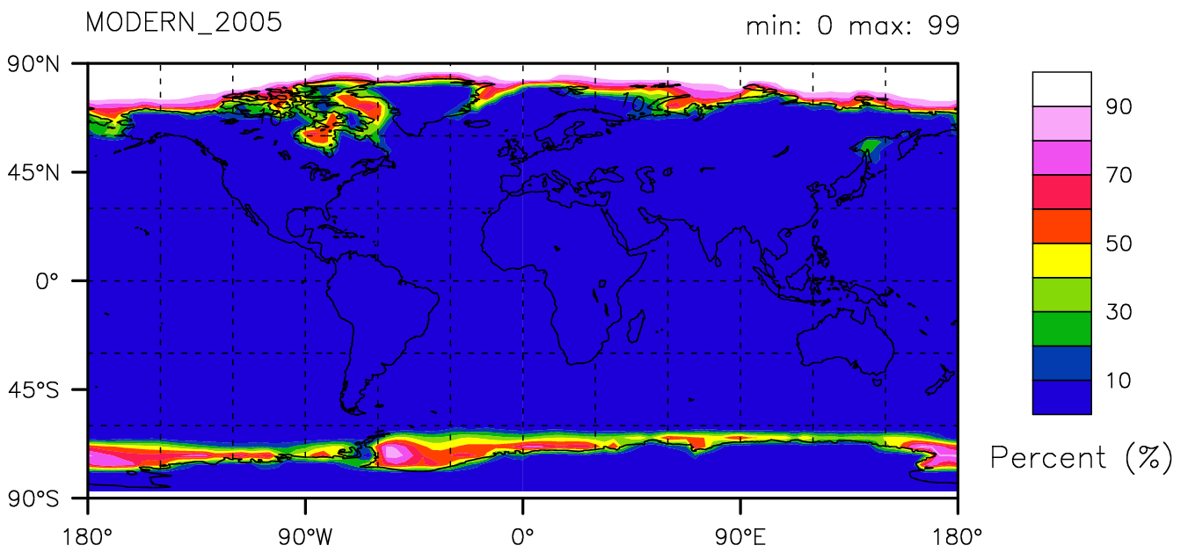
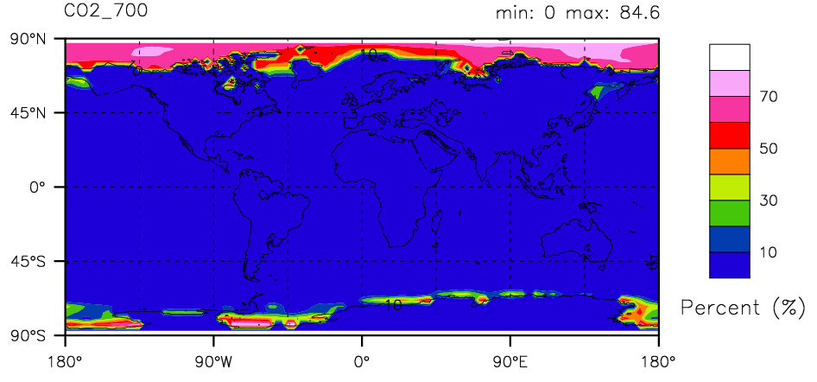
Annual sea ice extent

