Slide 1
Connecting to GMT machine via Windows 7

Slide 2
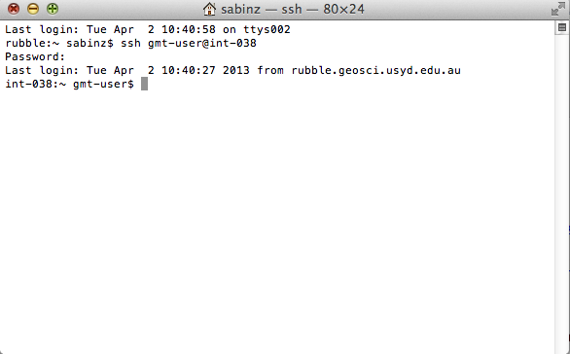
Windows
PuTTy
GMT on Mac server
int-038.geosci.usyd.edu.au
To use GMT, you will connect to a Mac server via PuTTy in Windows.
PuTTy established a secure connection (SSH) to the computer on the network.

Slide 3
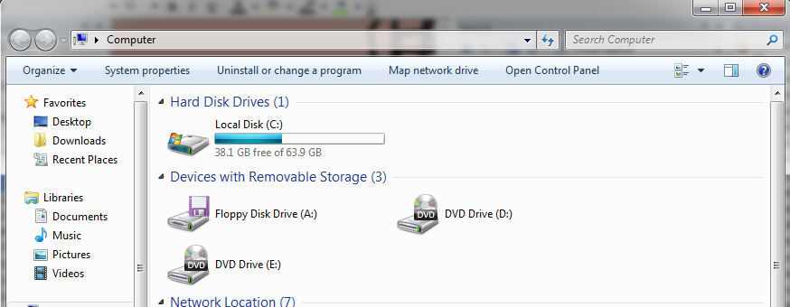
Map Network Drive in Windows
Open “My Computer”
Click “Map Network Drive”

Slide 4
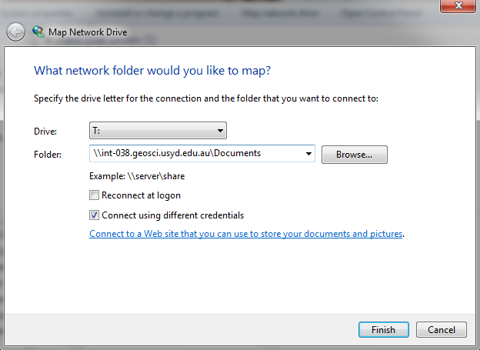

Slide 5
Enter the following
Drive letter: Any spare one
Folder: \\int-038.geosci.usyd.edu.au\Documents
Tick “Login using different credentials”

Slide 6
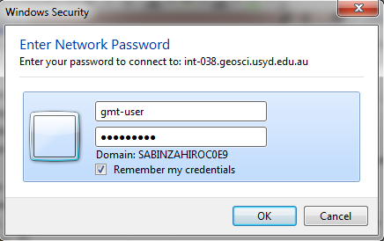
Login
You will be prompted for a username and password, enter: gmt-user wel0veGMT (^=zero)

Slide 7
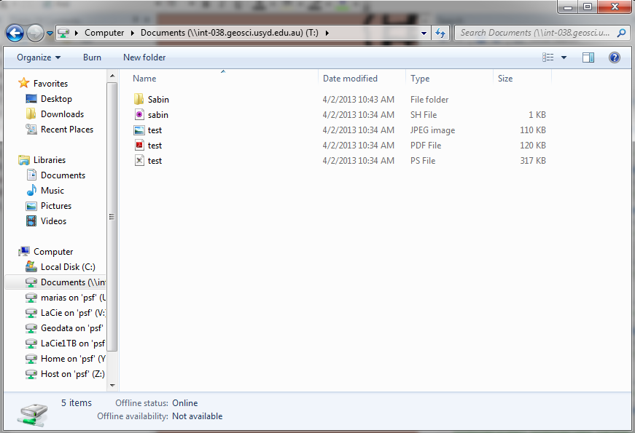
Important:
Create folder with your name!

Slide 8
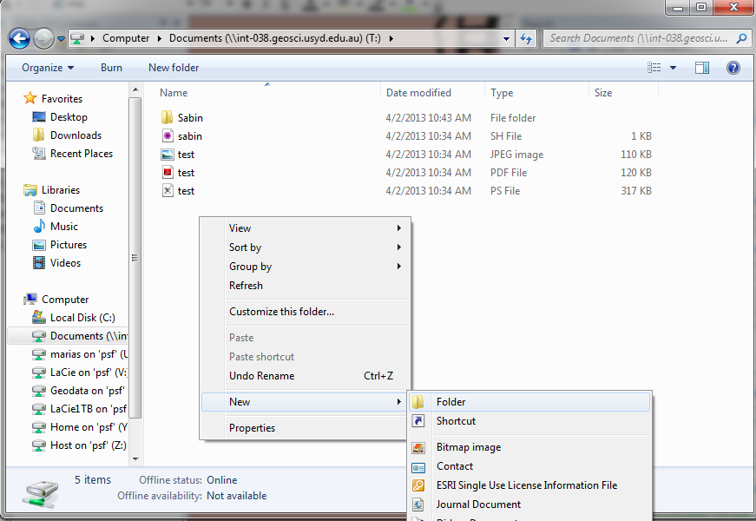
Create new folder
Right click inside “Documents” window
Select New > New Folder
Use your full name
This will be your workspace

Slide 9
Edit your GMT script using NotePad ++
All scripts should have the following in the first line: #!/bin/bash
Save script with “.sh” file extension

Slide 10
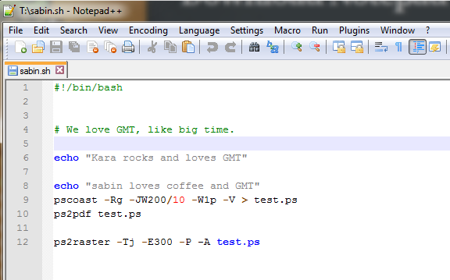

Slide 11
Run script via PuTTy
Open PuTTy from Start Menu
In the Host Name, type in: int-038.geosci.usyd.edu.au
Leave everything else as is
Click Open to establish connection

Slide 12
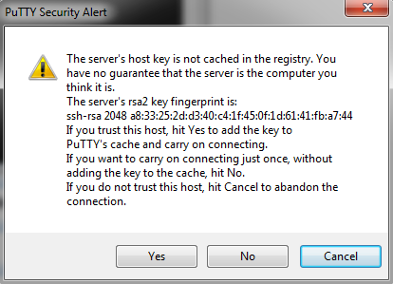
PuTTy
First time you connect, the following screen will appear:
Click YES

Slide 13
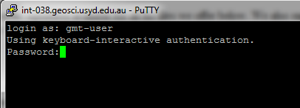
PuTTy
You will be prompted for your username and password gmt-user wel0veGMT

Slide 14
Navigate to YOUR workspace
In the Terminal window, type in cd Documents/FirstnameLastname and press Enter
e.g.
cd Documents/SabinZahirovic/
(cd means change directory)

Slide 15
Prepare and run your script
Type in “ls” and press Enter to list all your files
Convert your script to UNIX-text file, type in dos2unix YourFile.sh
Give your script execute (+x) permissions chmod +x YourFile.sh
Run your script ./YourFile.sh
Super
important!
If you do not do these steps, your script will not work.

